Slide 1

HUMAN MACHINE INTERACTION
DEPARTMENT OF COMPUTER ENGINEERING
SEMESTER VIII

Slide 2
Modules :
Foundations of HMI
Design and Software Process
Graphical User Interface
Screen Designing
Interface Design for Mobile Devices
Interaction Styles and Communication

Slide 3

Text Books
Galitz’s Human Machine Interaction, Dr. Dhananjay Kalbande, Wiley Publication
Human Computer Interaction, Alan Dix, Janet Finlay, Pearson Publication
The Essential Guide to User Interface Design, Wilbert O. Galitz, Wiley Publication
Mobile Design and Development, Brian Fling, O’Reilly Media

Slide 4
Rubric for Marking of term work
Lecture + Practical (% Attendance) & Marks | Assignments (2 Assignments) + Notebook | Lab / Practical Performance and Assessment | Mini Project | Total
05 Marks (Total attendance of Theory + Lab will get converted into 5 marks) | 05 Marks | 10 Marks | 05 Marks | 25 Marks

Slide 5
Internal assessment (IA) exam
IA1 | IA2 | Total
17/02/2020 10:00 am to 11:00 am | 13/04/2020 10:00 am to 11:00 am | 20 Marks

Slide 6
Blue print of MU QP
Modules | Question 1 | Question 2 | Question 3 | Question 4 | Question 5 | Question 6
#1 | √ | √ |  |  |  | √
#2 | √ |  | √ | √
#3 | √ | √ |  |  |  | √
#4 | √ |  | √ |  | √
#5 | √ |  |  | √ |  | √
#6 | √ |  |  |  | √ | √
 | 20 Marks | 20 Marks | 20 Marks | 20 Marks | 20 Marks | 20 Marks

Slide 7
Chapter 1- Foundations of HMI
What is HMI?
It is the way in which the machine is presented to the human

Slide 8
Hardware, Software and Operating Environments (HMI Components or IO Channels)
1. Hardware
Most important utility
Used to drive software
Today we choose hardware as per our requirements
Plenty hardware options are available and no need to compromise

Slide 9
2. Software
Tool to create an effective user interface
Based on requirements and hardware we need to choose software
It can use LLL, Assembly language or HLL
Many front end development tools using audio/visual experience to user

Slide 10
3. Operating environment
Fulfill user level acceptance test and can provide modification
Key points of user interface
Friends, family members, colleagues are not representatives of target users
User requirements should be understood by a team and not by an individual
Goal should be to minimize user difficulties
The hardware (device) and software balance should be maintained

Slide 11
The Psychopathology of everyday things
Human-Centered Design (May 16)
Considering different users and their aspects
Experience, knowledge, intelligence of users
Feedback
Constraints
Affordances (Convey the rules by leaving visual clues)
Power of observation

Slide 12
Norman’s Fundamental Principles of Interaction
Affordance (Visual clues that lead the user to understand functionality of the object)
Signifiers
Perceived Affordance
Mapping (Mapping of actions and consequences)
Feedback
Conceptual Models

Slide 13


Slide 14
Psychology of Everyday Action
Seven Stages of Action (May 17, Dec 18)
1. Forming the goal
Execution
2. Forming the intention (plan)
3. Specifying an action (specify)
4. Executing the action (perform)
Evaluation
5. Perceiving the state of the world (perceive)
6. Interpreting the state of the world (reflect)
7. Evaluating the outcome (compare)

Slide 15
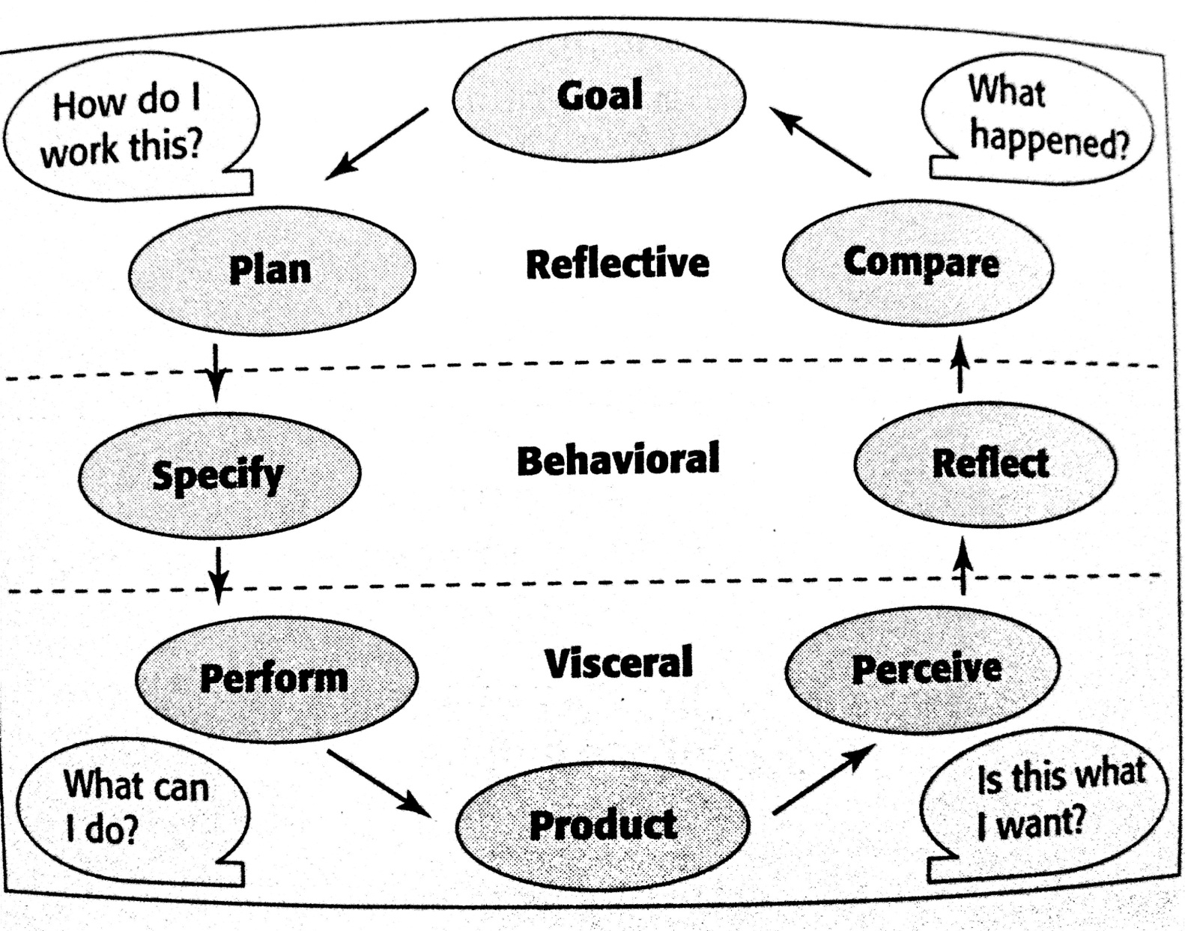
Three levels of Processing (May 16, Dec 16, May 17, Dec 18)
Visceral level
Behavioral level
Reflective level

Slide 16
Devices
Different Types of Devices
Text entry devices | The alphanumeric keyboard, QWERTY keyboard, Chord Keyboards, Phone pad or T9 Entry
Positioning, Pointing and Drawing | Mouse, Touchpad, Trackball/ Thumbwheel, Joystick, Touchscreens, Stylus or light pen, Eye gaze
Display Devices | Cathode ray tube (CRT), LCD, Large displays, Digital paper
Displays for virtual reality and 3D interaction
Physical controls, Sensors and special devices

Slide 17
Memory
RAM or Short term memory (STM)
Disks or Long term memory (LTM)

Slide 18
Processing and Networks
Limitations on interactive performances:
Computation bound
Storage channel bound
Graphics bound
Network capacity

Slide 19
Processing and Networks
Limitations on interactive performances:
Computation bound
Storage channel bound
Graphics bound
Network capacity

Slide 20
Models of Interaction
What is interaction?
The execution-evaluation cycle
1. Establishing the goal
2. Forming the interaction
3. Specifying the action sequence
4. Executing the action
5. Perceiving the system state
6. Interpreting the system state
7. Evaluating the system state with respect to the goals and intentions

Slide 21
Models of Interaction
What is interaction?
The execution-evaluation cycle
1. Establishing the goal
2. Forming the interaction
3. Specifying the action sequence
4. Executing the action
5. Perceiving the system state
6. Interpreting the system state
7. Evaluating the system state with respect to the goals and intentions

Slide 22
Ergonomics
It mainly represent the study of people’s efficiency in their working environment
It is a study of physical characteristics of interaction, how the controls are designed, the physical environment in which the interaction takes place, and the layout and physical qualities of the screen

Slide 23
Interaction Styles
Types of Interaction Styles:
Command line interface
Menus
Natural language
Question/Answer and query dialog
Form-fills and spreadsheets
WIMP
Point and click
Three-dimensional interface

Slide 24
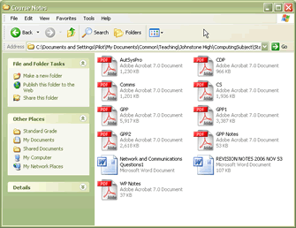
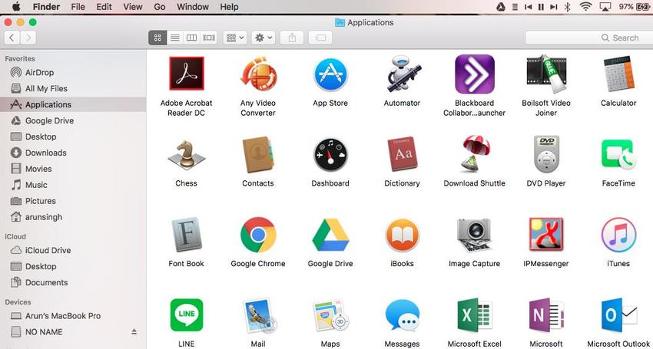
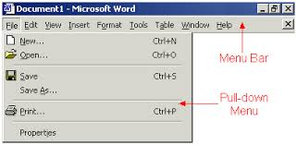
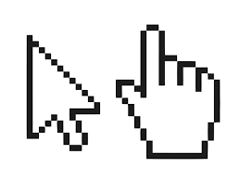
Elements of WIMP Interface
Windows
Icons
Menus
Pointers

Slide 25
Paradigms
Time sharing 13. Agent-based interface
Video display units 14. Ubiquitous computing
Toolkits 15. Sensor-based and context
Personal Computing aware interaction
Window system and WIMP interface
The metaphor
Direct manipulation
Language versus action
Hypertext
Multi-modality
Computer supported cooperative work
World wide web

Slide 26
Chapter 2- Design and software process
Mistakes performed while designing a computer system
Developers expect people to think like computers
Developers asks user to perform difficult operations (that may not be difficult for developers)
The resultant software design will have poor behaviour
Users are ignored

Slide 27
Why people have trouble with computers
Use of jargon
Non obvious design
Fine distinctions
Disparity in problem solving strategies
Design inconsistency

Slide 28
Responses to poor design
Psychological | Physical
Confusion | Abandonment of the system
Annoyance | Partial use of the system
Frustration | Indirect use of the system
Panic or Stress | Modification of the task
Boredom | Compensatory activity
 | Misuse of the system
 | Direct programming

Slide 29
Human Characteristics in Design
Perception
Memory
Sensory storage
Visual acuity
Foveal and peripheral vision
Information processing
Mental model
Movement control
Learning
Skill
Individual differences

Slide 30
Human Considerations in Design
The user’s knowledge and experience Computer literacy System experience Application experience Task experience Other system use Education Reading level Typing skill Native language and culture | The user’s tasks and needs Mandatory or discretionary use Frequency of use Task or need importance Task structure Social interactions Primary training Turnover rate Job category Lifestyle
The user’s Psychological characteristics Attitude and Motivation Patience Stress level Expectations Cognitive style | The user’s Physical characteristics Age Gender Handedness Disabilities

Slide 31
Human Interaction Speeds
Reading
Listening
Speaking
Keying

Slide 32
What is Design
Achieving goals within constraints
Goals
Constraints
Trade-off
Golden Rule of Design
Understand your materials
Understand computers
limitations, capacities, tools, platforms
Understand people
psychological, social aspects, human errors

Slide 33
The Process of Design
Requirements- What is wanted
Analysis
Design
Iteration and prototyping
Implementation and deployment

Slide 34
User Focus
Know your users
Who they are?
Probably not like you!
Talk to them
Watch them
Use your imagination

Slide 35
Scenarios
Communicate with others
Validate other models
Express dynamics
Time is linear
But no alternatives

Slide 36
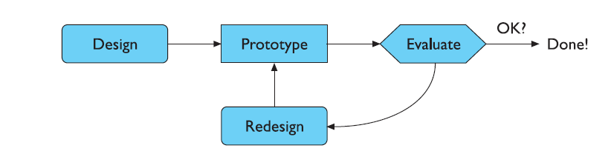
Iteration and Prototyping
Formative Evaluation
Summative Evaluation
Role of prototyping:

Slide 37
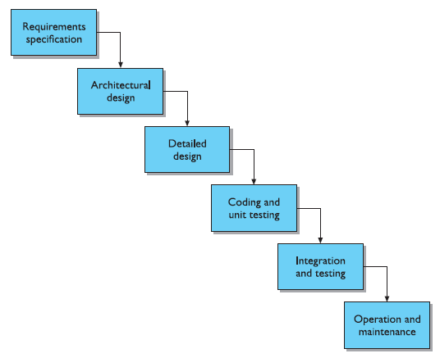
Software Life Cycle

Slide 38
Usability Engineering
The engineering that depends on interpretation against a shared background of meaning, agreed goals and an understanding of how satisfactory completion will be judged.
The emphasis for usability engineering is in knowing exactly what criteria will be used to judge a product for its usability.
The ultimate test of a product’s usability is based on measurements of users’ experience with it. Therefore, since a user’s direct experience with an interactive system is at the physical interface, focus on the actual user interface is understandable.

Slide 39
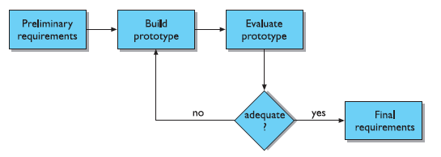
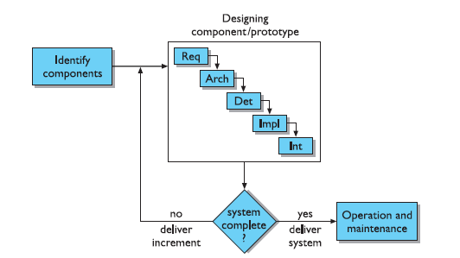
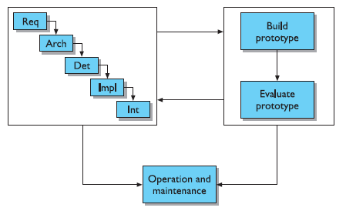
Iterative Design and Prototyping
Throw-away prototyping
Incremental prototyping Evolutionary prototyping

Slide 40
Design Rationale
It provides a communication mechanism among the members of a design team
Accumulated knowledge in the form of design rationales for a set of products can be reused to transfer what has worked in one situation to another situation which has similar needs.
The effort required to produce a design rationale forces the designer to deliberate more carefully about design decisions.
There is usually no single best design alternative. Even if an optimal solution did exist for a given design decision, the space of alternatives is so vast that it is unlikely a designer would discover it.
The usability of an interactive system is very dependent on the context of its use.

Slide 41
Design Rules/ Principles to Support Usability
Learnability | Flexibility | Robustness
Predictability | Dialog initiative | Observability
Synthesizability | Multi-threading | Recoverability
Familiarity | Task migratability | Responsiveness
Generalizability | Substitutivity | Task conformance
Consistency | Customizability

Slide 42
Shneiderman’s Eight Golden Rules
Strive for consistency
Enable frequent users to use shortcuts
Offer informative feedback
Design dialogs to yield closure
Offer error prevention and simple error handling
Permit easy reversal of actions
Support internal locus of control
Reduce short term memory load

Slide 43
Norman’s 7 Principles to Transforming Difficult Tasks Into Simple Ones
Use both knowledge in the world and knowledge in the head
Simplify the structure of tasks
Make things visible
Get the mappings right
Exploit the power of constraints
Design for error
When all else fails, standardize

Slide 44
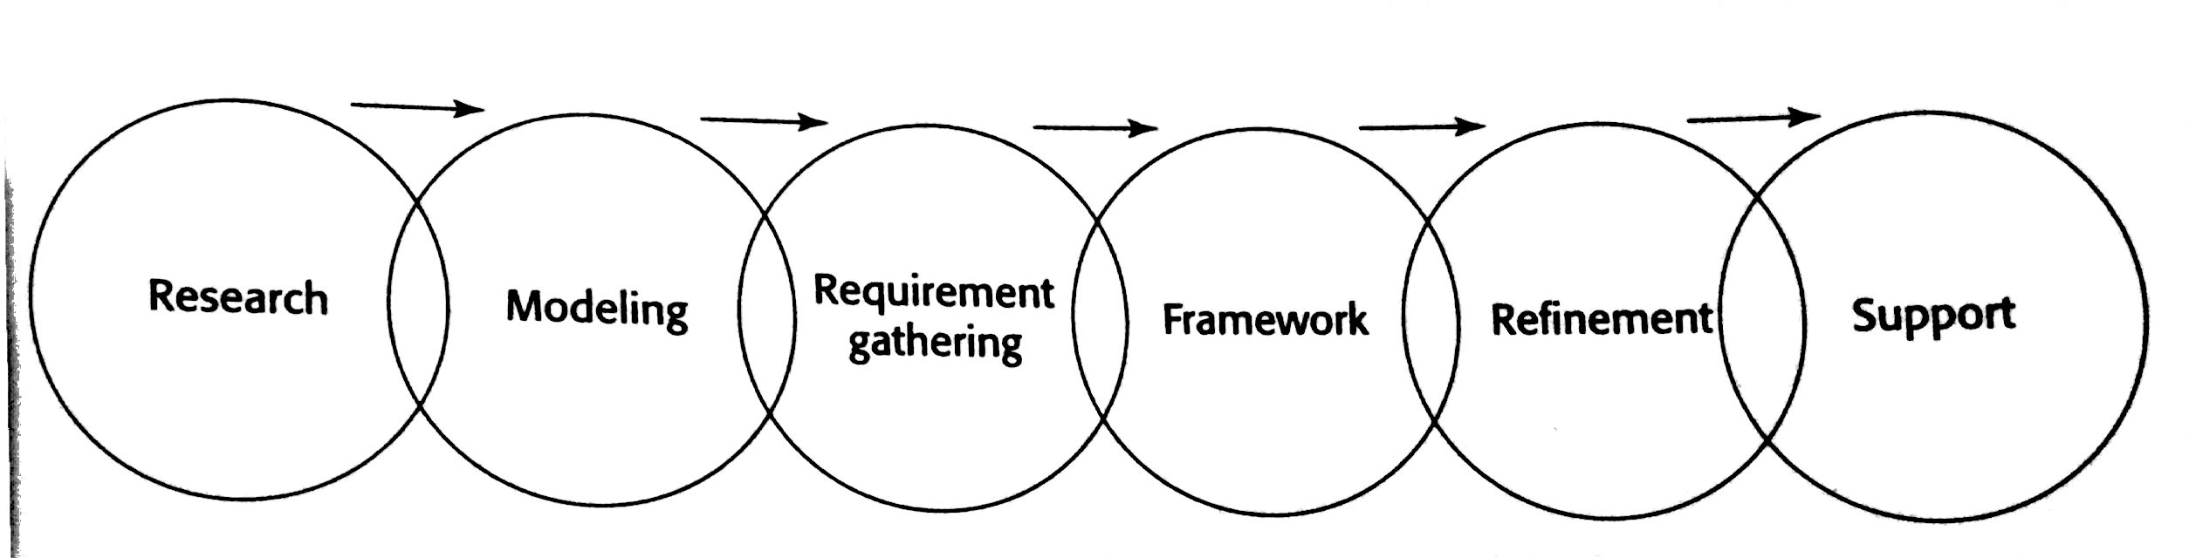
Goal Directed Design Process (Dec 17, May 17, Dec 16, Dec 18)

Slide 45
Chapter 3- Graphical user interface
The Concept of Direct Manipulation (Dec 17, Dec 16, May 16)
Characteristics:
The system should portrayed as an extension of the real world
Continuous visibility of objects and actions
Actions should rapid and incremental with visible display and results
Incremental actions should easily reversible

Slide 46
Graphical Systems (Dec 17, Dec 16, Dec 18)
Advantages:
Symbols recognized faster than text
Faster learning
Faster use and problem solving
Easier remembering
More natural
Fewer errors
Less difficult for new user
More attractive
Replaces natural languages
Low typing requirements

Slide 47
Disadvantages
Greater design complexity
Learning still necessary
Not always familiar
Human comprehension limitations
Window manipulation requirements
Production limitations
Inefficient for expert users
Increased chances of clutter and confusion
May consume more screen space
Hardware limitations

Slide 48
Characteristics of Graphical user interface
Sophisticated visual presentation
Pick and click interaction
Restricted set of interface options
Visualization
Object orientation
Collection
Constraints
Composites
Container
6. Use of recognition memory
7. Concurrent performance of functions

Slide 49
Principles of User interface design (May 17)
Visual pleasing
Availability
Clarity
Compatibility
Configurability
Directness
Efficiency
Familiarity
Flexibility
Forgiveness
11. Predictability
12. Recovery
13. Responsiveness
14. Simplicity
15. Transparency

Slide 50
GUI versus Web Page Design (May 16)
Characteristics | GUI | Web
Devices | Hardware variations are limited | User hardware variations enormous
User Focus | Data and application | Information and navigation
User Tasks | Install, Configure, Personalize, use and upgrade programs etc | Linking, Browsing, Filling forms, Downloading, Saving etc
Presentation Elements | Windows, menus, controls, toolbars, messages and so on | Browser and page
Navigation | Through menus, lists, trees, dialogs etc | Through links, bookmarks and typed URLs
Interaction | Clicking menu choices, pressing buttons, selecting list choices and cut/copy/paste | Basic interaction is single click. This can cause extreme changes in context
Response Time | Nearly instantaneous | Quite variable depending upon transaction speeds, page content and so on
Visual Style | Visual creativity allowed but difficult | Fosters a more artistic, individual and unrestricted presentation style

Slide 51
Characteristics | GUI | Web
Task Efficiency | Targeted to a specific audience with specific tasks | Actual user audience usually not well understood, often intended for anyone and everyone
User Assistance | Integral part of most systems and applications | No similar help system is normally available
Security | Tightly controlled | Not effectively secure and renowned for security exposures
Reliability | Tightly controlled in business systems | Susceptible to disruptions caused by user, telephone line, ISP, Servers etc.

Slide 52
Printed Pages versus Web Pages (Dec 17)
Characteristics | Printed Pages | Web Pages
Page Size | Larger than web pages and fixed in size | Normally lesser than printed pages and variable in size
Page Rendering | Superior than web pages as they are presented as complete entities and their entire contents are available for reading and review immediately upon appearance | Web pages elements are often rendered slowly, depending upon speed and page content
Page Layout | Layout is precise with much attention given to it | Layout is more of an approximations
Reading | More better and reading is faster | Screen reading is slower than reading from document
User Focus | It present people with entire set of information | Present people with individual snapshots of information and body of web information is almost unlimited
Page Navigation | Simple as page turning | It requires innumerable decisions concerning which of the many possible links should be followed

Slide 53
Characteristics | Printed Pages | Web Pages
Sense of Place | With proper documents you derive a sense of where you are through proper organization | Electronic documents none of any physical clues
Interactivity | It involves letting the eyes traverse static information selectively looking at information and using spatial combinations to make page elements enhance and explain each other | It involves letting the hands move the information in conjunction with the eyes
Page Independence | Printed pages are not considered independent | Moving between web pages is so easy and any page from site can be accessed from anywhere else, every page is independent and topic and contents must be explained without assumptions about any previous page seen by the user

Slide 54
The merging of Graphical business systems and the Web Intranet vs Internet
Characteristics | Intranet | Internet
Users | Organization employees who know about organization | Customers and others who know much less about the organization
Tasks | Everyday activity including transactions, queries and communication | Find information and simple transactions
Type of information | Detailed information needed for organization functioning which often be added and modified | Stable information includes marketing, customer reports etc.
Amount of information | Much larger than internet site | Less than intranet site
Hardware and Software | Computers, monitors, browsers, and other software are restricted and standardized | Rich graphics, multimedia and screen elements are high definitions
Design Philosophy | Text based and GUI applications | GUI and Web applications

Slide 55
Chapter 4- Screen designing
Design Goals:
Reduce visual work
Reduce intellectual work
Reduce memory work
Reduce motor work
Minimize or eliminate any burdens or instructions imposed by technology.

Slide 56
Ordering of Screen Data and Contents
Conventional
Sequence of use
Frequency of use
Function or category
Importance
General to specific

Slide 57
Visually Pleasing Composition
Balance
Symmetry
Regularity
Predictability
Sequentiality
Economy
Unity
Proportion
Simplicity
10. Groupings

Slide 58
Focus and Emphasis
Brightness
Reverse polarity
Fonts
Underlining
Blinking
Line rulings and surrounding boxes or frames
Colors
Other emphasis techniques
De-emphasize less important elements
Avoid too much emphasis

Slide 59
Presenting Information Simply and Meaningfully
Legibility
Readability
Usability
Contrast display features
Visual lines
Consistency

Slide 60
Information Retrieval On Web
A. Reading on web
Initial focus of attention
Page perusal
Scanning guidelines:
a. Organization
b. Writing
Concisely write the page text
Bulleted and numbered lists
c. Presentation

Slide 61
Information Retrieval On Web
B. Browsing
Facilitate scanning
Provide multiple layers of structure
Respect the user’s desire to leave
Upon returning, help the users reorient themselves

Slide 62
Information Retrieval On Web
C. Searching
Problems with search facilities:
Not understanding the users
Difficulties in formulating the search
Difficulties in presenting meaningful results
Search facility guidelines:
Know your search users- Expertise/ Anticipate/ Switching purposes
Express the search- What/ Where/ How
Progressive search refinement
Present meaningful results

Slide 63
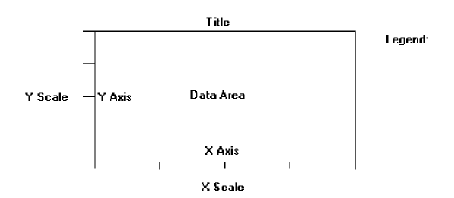
Statistical Graphics
Components of statistical graphics

Slide 64
Data presentation
Emphasis on data minimize on non data elements
Redundant data
Proper context
Restrict information carrying dimensions
Employ data in multiple ways
Avoid unnecessary embellishment
Fill the display area

Slide 65
2. Axes
3. Scales and scaling
1. Tick marks
2. Linear Scales
3. Scale markings
4. Starts a numeric scales at zero
5. Minimization of scale digits
6. Single scale on each axes
7. Duplicate axes for large matrics
8. Scale interpretation
9. Consistency
10. Labeling

Slide 66
4. Proportion
5. Lines
6. Labeling
1. Clear and detailed
2. Left to right
3. Integrate
4. Separation
5. Source
6. Legends
7. Title
8. Aiding interpretation of numbers

Slide 67
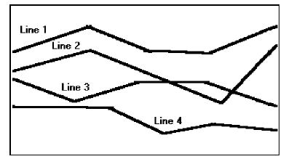
Types of statistical graphics
Curve and line graphs
1. Single graphs
2. Four or five maximum
3. Label identification
4. Tightly packed curves or lines
5. Important or critical data
6. Comparing actual or projected data

Slide 68
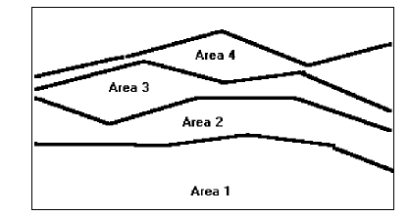
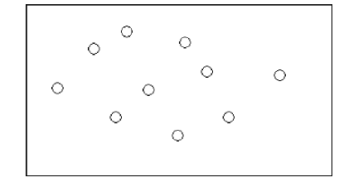
Surface charts
1. Ordering
2. Coding schemes
3. Labels
Scatter plots
1. Two dimensions
2. Consistent intervals
3. Distinguishable plots
4. Multiple data sets

Slide 69
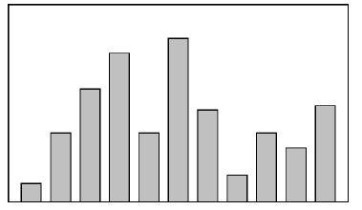
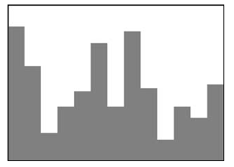
Bar graphs
1. Consistent orientation
2. Meaningful orientation
3. Bar spacing
4. Differentiation
5. Important or critical data
6. Reference index
7. Labeling
8. Histogram or step charts

Slide 70
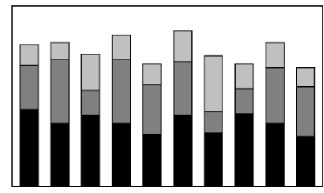
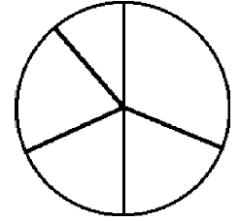
5. Segmented or stacked bar
1. Data category ordering
2. Large segments
3. Coding schemes
4. Labeling
6. Pie charts
1. Total 100 percent
2. Five segment or fewer
3. Minimum five percent
4. Start at 12.00
5. Labeling
6. Numbers with segment labels
7. Highlighting
8. Tilting

Slide 71
7. Flow chart
1. Order of steps
2. Orientation
3. Coding conventions
4. Arrows
5. Highlighting
6. Only one decision at each step
7. Consistency

Slide 72
Technological Considerations in System Design
Graphical Systems
1. System Power
2. Screen size
3. Screen resolution
4. Colors
5. Other display features
6. Platform compatibility
7. Development and implementation tool compatibility
8. Style guide compatibility

Slide 73
2. Web Systems
1. Browser
1. Compatibility
2. Monitor size and resolution
3. Fonts
4. Colors
5. Bandwidth
6. Versions
2. Other Web Considerations
1. Downloading
2. Currency
3. Page printing
4. Maintainability

Slide 74
Chapter 6- Interaction Styles and communication
Windows Characteristics:
1. A name or title, allowing to be identified
2. A size in height and width
3. A state, accessible or active, or not accessible
4. Visibility- the portion that can be seen
5. Display boundary
6. Presentation
7. Management capabilities
8. Its highlight, that is, the part that is selected
9. The function, task, or application to which it is dedicated

Slide 75
Components of Windows
Frame
Title bar
Title bar icon
Window sizing buttons
What’s this ? Button
Manu bar
Status bar
Scroll bars
Split box
Toolbar
Command area
Size grip
Work area

Slide 76
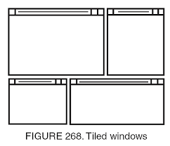
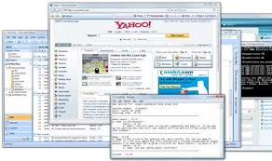
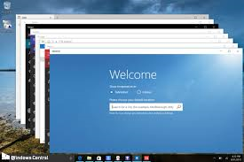
Window Presentation Styles (May 17)
Tiled Windows
Overlapping Windows
Cascading Windows

Slide 77
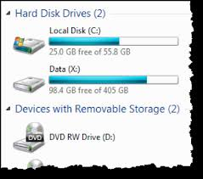
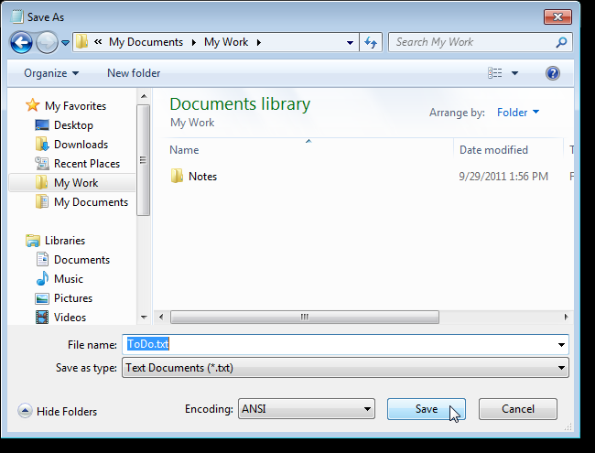
Types of Windows (Dec 17, May 16)
Primary Windows
Secondary Windows
Modal and Modeless
Cascading and Unfolding
Dialog Boxes
Property Sheets and Property Inspectors
Message Boxes
Palette Windows
Pop-up Windows

Slide 78
Window Management
Single-document interface
Multiple-document interface
Workbooks
Projects

Slide 79
Organizing Window Functions (Window Operations)
Window organization
Number of windows
Active window
General guidelines
Opening a window
Sizing or resizing windows
Window placement
Window separation
Moving a window
Other operations- Maximizing/ Minimizing/ Shuffling
Closing a window

Slide 80
Words, Sentences, Messages and Text
Words
Jargon
Abbreviations or acronyms
Short familiar words
Complete words
Positive terms
Consistent words

Slide 81
Sentences
Brief and simple
Directly and immediately usable
Affirmative statement
Active voice
Temporal sequence
Main topic at beginning
Non authoritarian
Non threatening
Punishment and humor

Slide 82
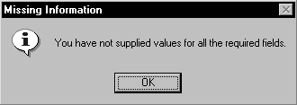
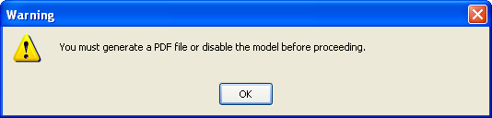
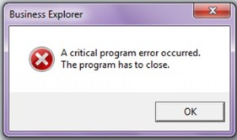
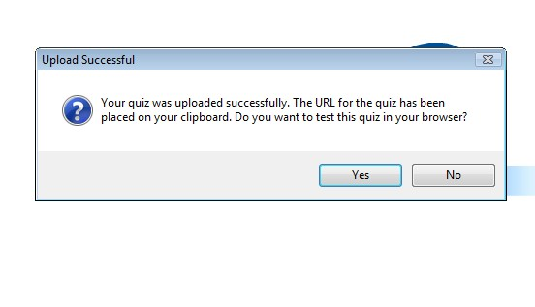
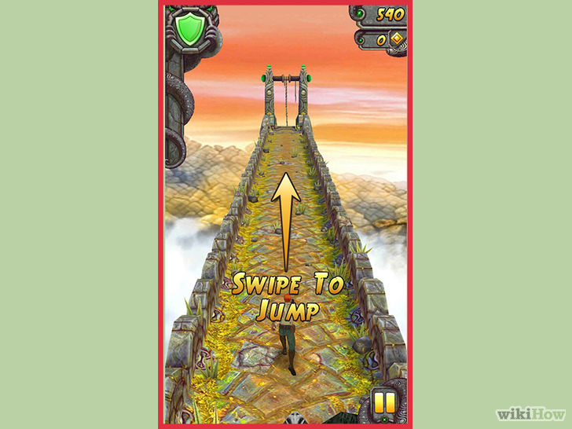
Messages (May 16)
A. System messages
Status messages
Informational messages
Warning messages
Critical messages
Question messages
B. Instructional messages

Slide 83
Text
Presenting text
1. Fonts
2. Content
3. Style
4. Miscellaneous

Slide 84




Icons and Multimedia
Icons
A. Kinds of icons
1. Resemblance
2. Symbolic
3. Exemplar
4. Arbitrary
5. Analogy

Slide 85
B. Technical qualities
1. Syntactics
2. Semantics
3. Pragmatics

Slide 86
C. Characteristics
1. Clarity
2. Familiarity
3. Simplicity
4. Consistency
5. Directness
6. Efficiency
7. Discriminability
8. Expectancies

Slide 87
D. Choosing icons
1. A successful icons
2. Size
3. Color
4. Icon selection
5. Hot zone
E. Choosing images
1. Existing icons
2. Nouns
3. Traditional images
4. Cultural or social norms

Slide 88
F. The design process
1. Define purpose
2. Collect, evaluate and sketch ideas
3. Draw in black and white
4. Test for expectations, recognition and learning
5. Test for legibility
6. Register new icon in the system registry

Slide 89
Multimedia
A. Graphics
1. Supplement textual content
2. Convey information not possible using text
3. Limit long loading graphics
4. Enhance navigation

Slide 90
Multimedia
B. Images
1. Standard images
2. Consistency
3. Legibility
4. Descriptive text or labels
5. Navigational and decorative images
6. Minimize number of images
7. Minimize size of an image
8. Thumbnail size
9. Minimize animation
10. Minimize the number of colors
11. Appropriate format

Slide 91
Multimedia
C. Photographs/Pictures
1. Use
2. Guidelines
D. Videos and audios
1. Use
2. Guidelines

Slide 92
Multimedia
E. Diagrams and drawings
1. Use
2. Guidelines
F. Animation
1. Use
2. Guidelines

Slide 93
Colors (Dec 17, Dec 16)
A. Possible problems with colors
1. High attention getting capacity
2. Interference with use of other screens
3. Varying sensitivity of the eyes to different colors
4. Color viewing deficiencies
5. Cross disciplinary and cross cultural differences

Slide 94
B. Choosing colors
1. Choosing colors for categories of information
2. Discrimination and harmony
3. Emphasis
4. Common meanings
5. Location
6. Foreground and background
7. Color palette, defaults and customization
8. Gray scale
9. Monochromatic screens
10. Consistency
11. Cultural, disciplinary considerations

Slide 95
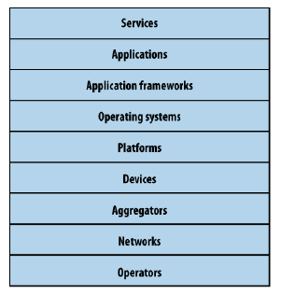
Chapter 5- interface design for mobile devices
Mobile Ecosystems:
JAVA, Flash light, Web, COCOA touch etc.
Licensed, Proprietary, Open Source

Slide 96
Types of Mobile Applications
SMS
Mobile websites
Mobile web widgets
Mobile web applications
Native applications
Games
Informative applications

Slide 97
Mobile Information Architecture
Site maps
Simplicity (Keep it simple)
Clickstreams (Behaviour)
Wireframes
Prototyping
Paper prototype
Context prototype
HTML prototype

Slide 98
Mobile 2.0
Mobile 2.0: The Convergence of the Web and Mobile
The Mobile Web Browser As the Next Killer App
Mobile Web Applications Are the Future
JavaScript Is the Next Frontier
The Mobile User Experience Is Awful
Mobile Widgets Are the Next Big Thing
Mobile Needs to Check Its Ego
We Are Creators, Not Consumers

Slide 99
Elements of Mobile Design
Context
Message
Look and feel
Layout
Colour
Typography
Graphics

